Slide 1

BUILD AN E-COMMERCE WEBSITE USING AWS SERVICES
AWS LAMBDA,AWS S3,AWS ROUTE 53
Chandana Siram
2000039020
Sec:14

Slide 2
E-COMMERCE
Ecommerce analytics is the process of collecting data from all of the sources that affect a certain shop. Analysts can then utilize this information to deduce changes in customer behavior and online shopping patterns.
For most applications, websites can run with only client side code and be comprised of only HTML, CSS and JavaScript. Such websites are usually defined as static websites. With no server side code to run or maintain there is no point in using conventional web servers.
Amazon Web Services (AWS) offers multiple options for hosting static or dynamic websites. For static content, the simplest and most affordable option is the Amazon Simple Storage Service (S3).

Slide 3
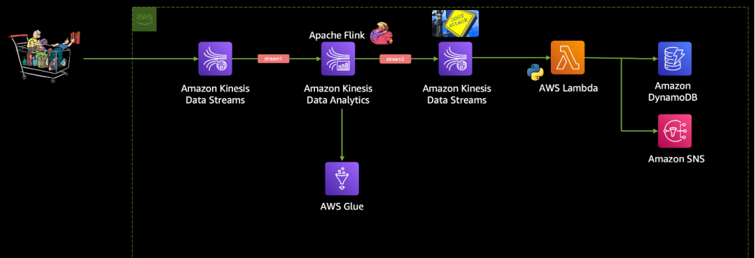
Architecture DIAGRAM

Slide 4
Aws Services Used
Amazon s3: Amazon S3 is an object storage service that provides manufacturing scalability, data availability, security, and performance. Users may save and retrieve any quantity of data using Amazon S3 at any time and from any location.
Amazon route 53: Amazon Route 53 is a highly available and scalable Domain Name SysteM web service. Route 53 connects user requests to internet applications running on AWS or on-premises.

Slide 5

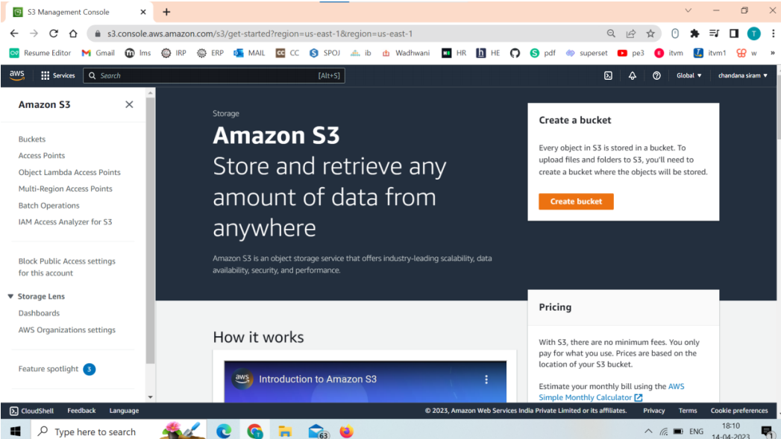
Create S3 bucket:

Slide 6
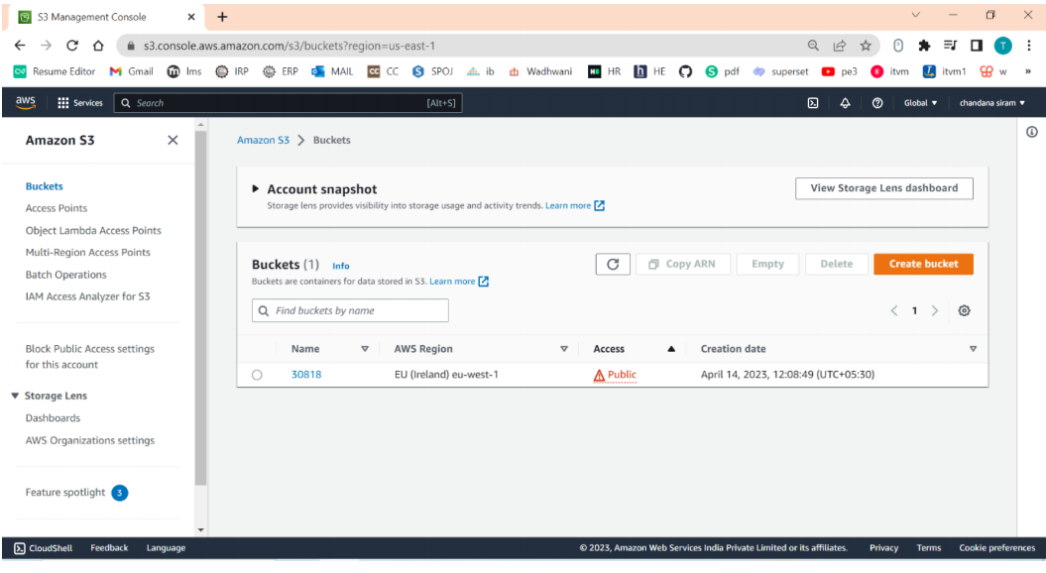
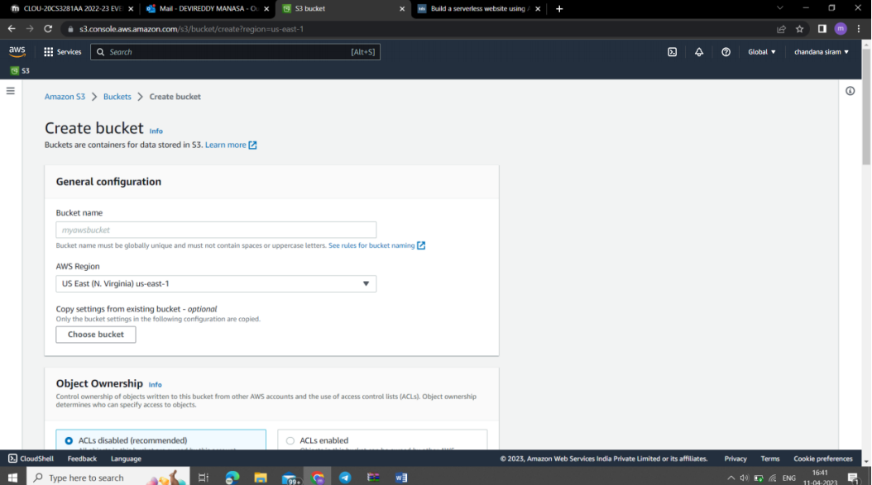

Slide 7
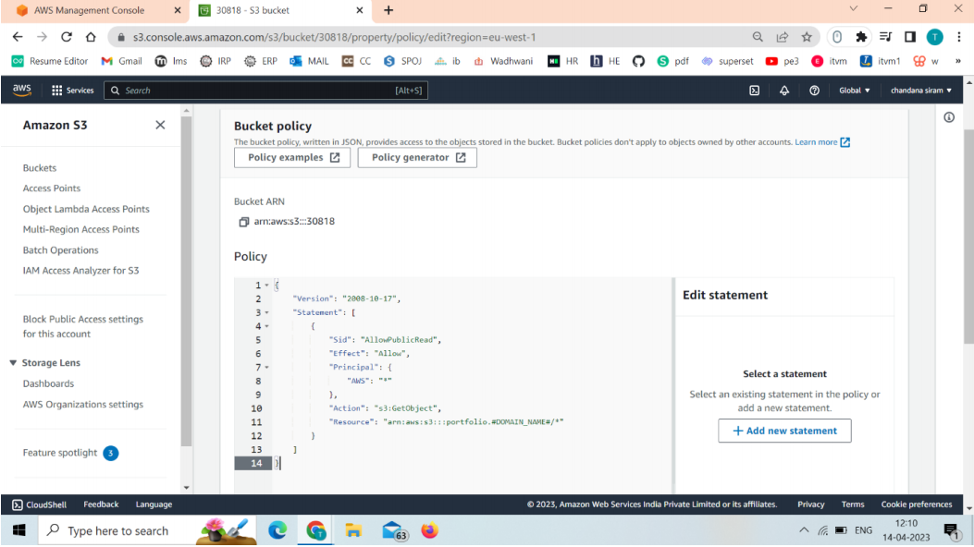
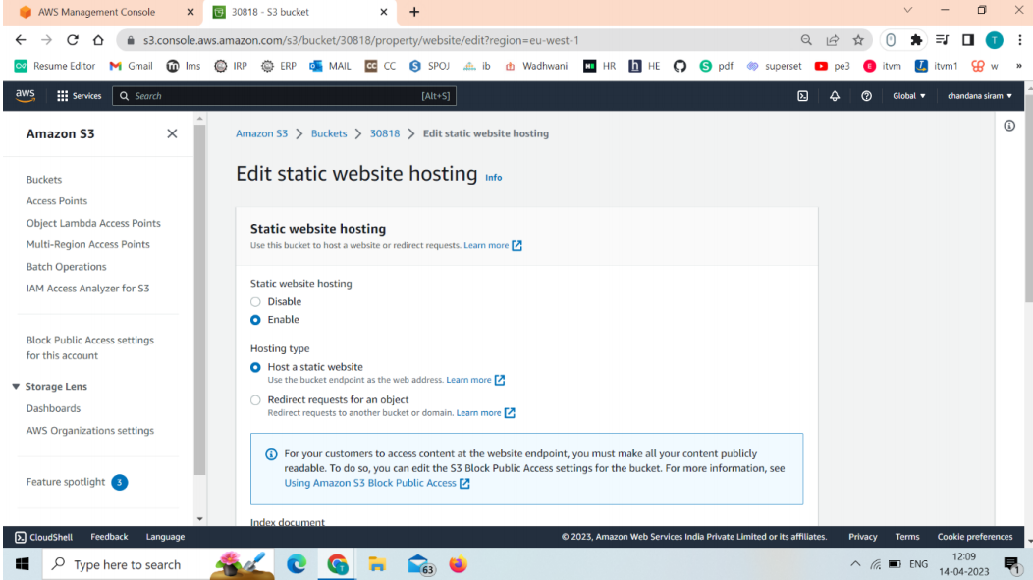

Slide 8
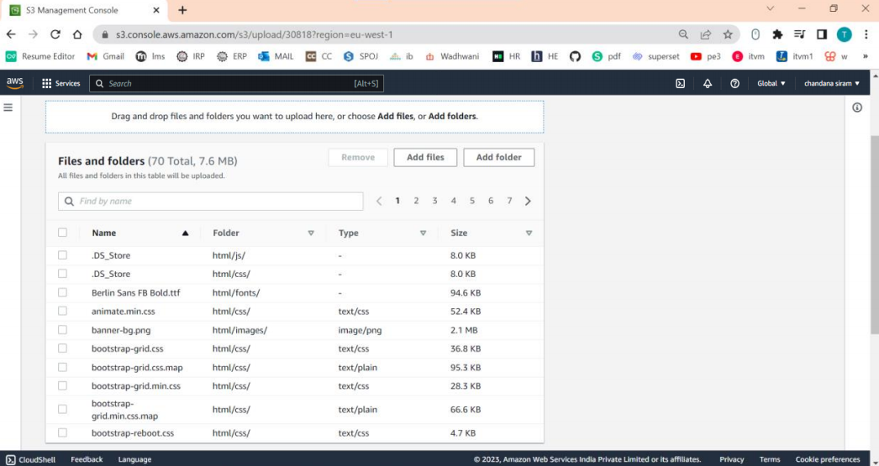
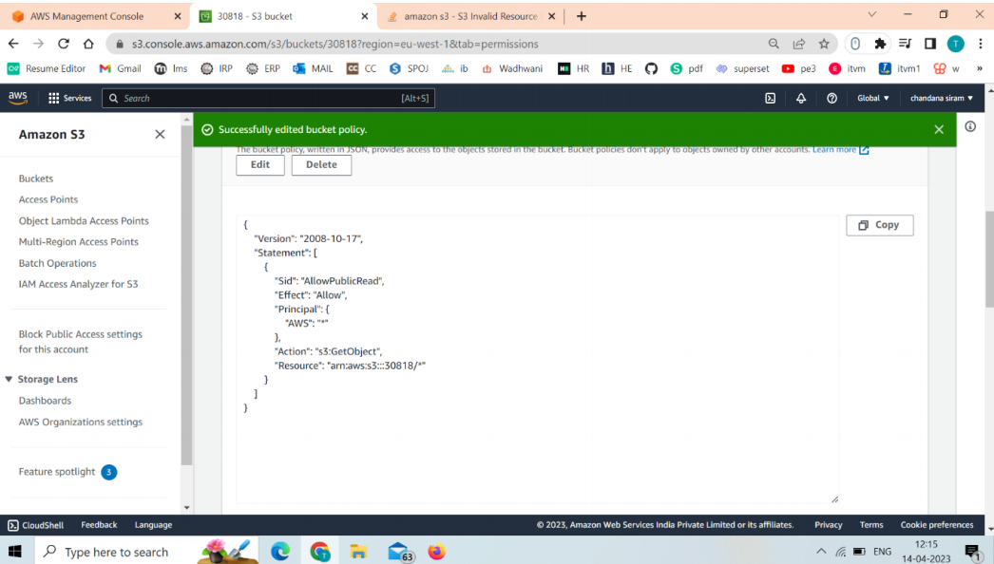

Slide 9
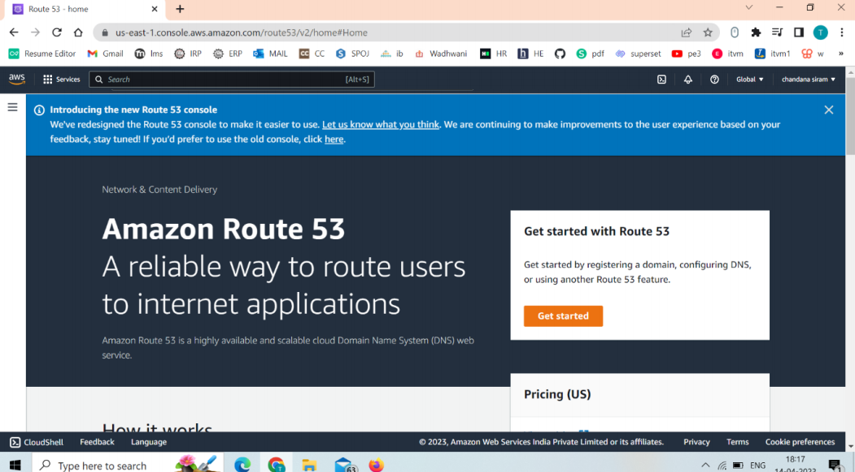
Host a website in Amazon S3
S3 Providing a simple interface to store and retrieve data in a highly scalable and reliable way. Not only this, but storing data in Amazon S3 is a viable and affordable solution.

Slide 10
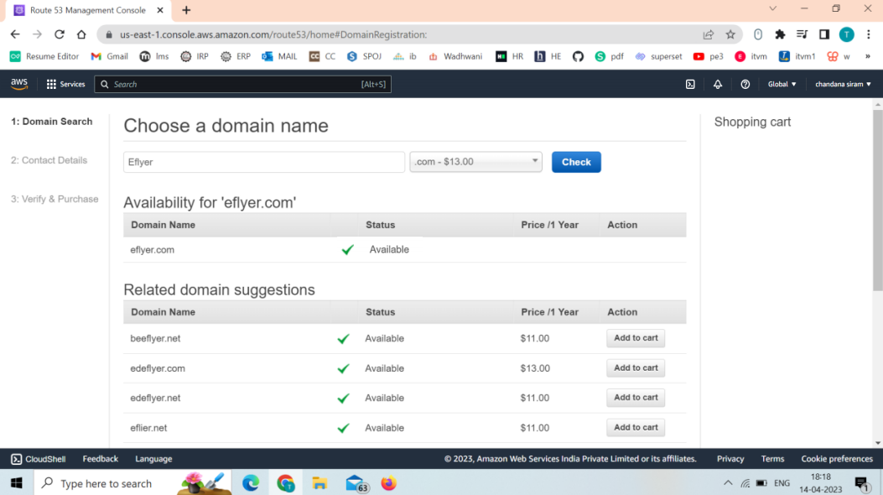
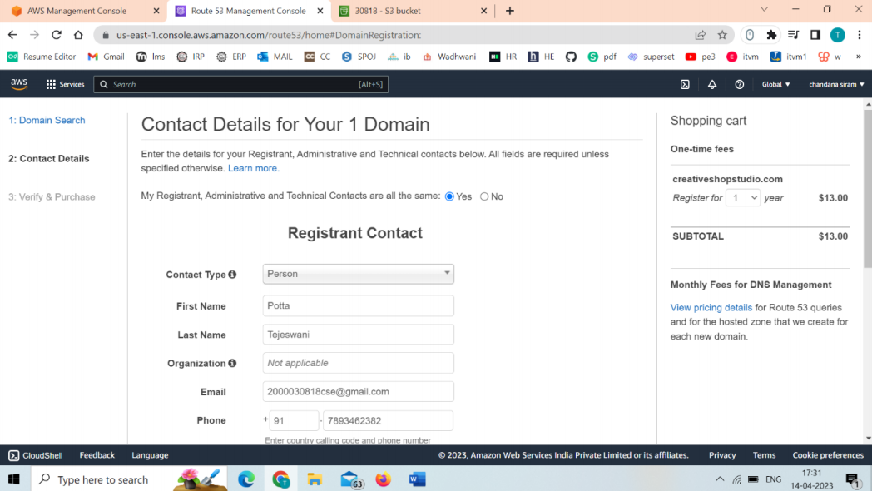

Slide 11
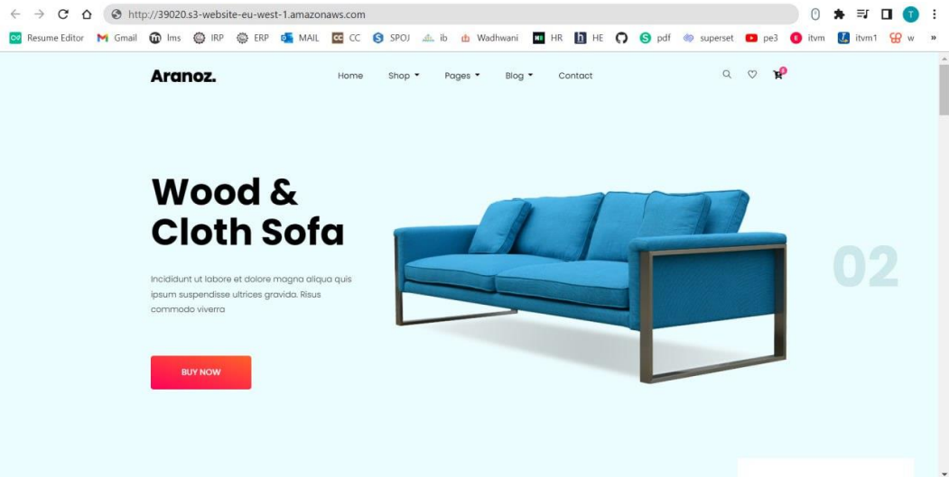
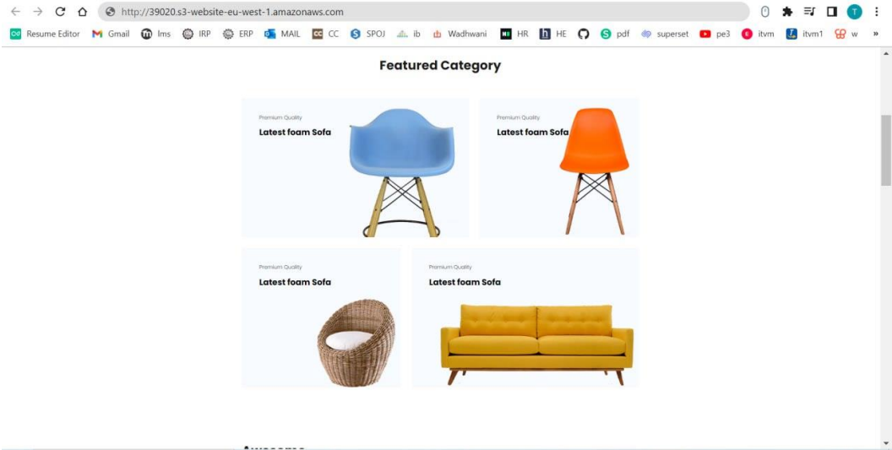
OUTPUT

Slide 12

THANKYOU

